Slide 1
IOT BASED FLOOD DETECTING SYSTEM
BY:
B. Pramod 18BEC007
D. Naveen Nischal 18BEC011
Kavya F Kamadolli 18BEC021
N.Mahantesh 18BEC025
Shobhraj 18BEC044
Submitted to:
DR. Jagadeesha R Bhatt
Asst.Professor

Slide 2
Contents
Introduction
Objectives
Flowchart
Limitations
Hardware components
Block diagram and program
Outcome and results
References

Slide 3
Introduction
Flood is one of the natural disaster that cannot be avoided totally. Every year death rate due to flood increases because of absence of early warning.
To solve this problem this project demonstrates the idea and implementing of a Flood Detecting System through IOT technology.

Slide 4
This system comprises of three parts:
First part is detecting the water level using ultra sonic sensor.
The second part is sending the information to the cloud using blynk.
The third part is sending the alert message through Blynk.
IoT is the technology used for monitoring, collecting, controlling and connecting the system to worldwide, which is the more efficient and advanced solution for accessing the information in the world. This system proposes a real-time flood detecting system.

Slide 5
Objectives
This project aims to monitor the flood condition and send alert if there is an occurrence of risk through IOT.
The measurement of rising water level is done to detect the flood.
The system uses ultrasonic sensor to detect water levels at every stage

Slide 6
Flow chart
Collecting the data from sensors through Nodemcu
The data will be collected at Nodemcu will be sent to cloud using wifi
The data will be received in our cloud platform:BLYNK
The data will be accessed through phone app blynk anywhere from the world
The future data will be predicted using recorded data

Slide 7
Hardware Components
Ultrasonic sensor
Nodemcu-ESP8266
Jumper wires
Breadboard

Slide 8
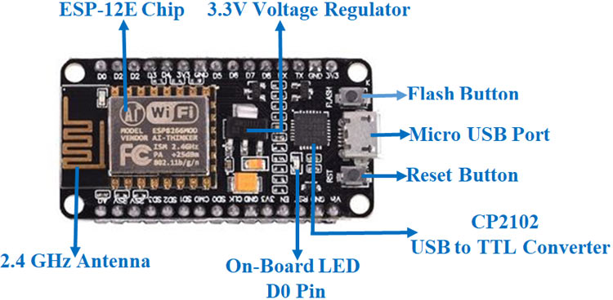
Nodemcu-ESP8266

Slide 9
The NodeMCU ESP8266 development board comes with the ESP-12E module containing ESP8266 chip having Tensilica Xtensa 32-bit LX106 RISC microprocessor. This microprocessor supports RTOS and operates at 80MHz to 160 MHz adjustable clock frequency.
NodeMCU has 128 KB RAM and 4MB of Flash memory to store data and programs. Its high processing power with in-built Wi-Fi / Bluetooth and Deep Sleep Operating features make it ideal for IoT projects. NodeMCU can be powered using Micro USB jack and VIN pin (External Supply Pin). It supports UART, SPI, and I2C interface.

Slide 10
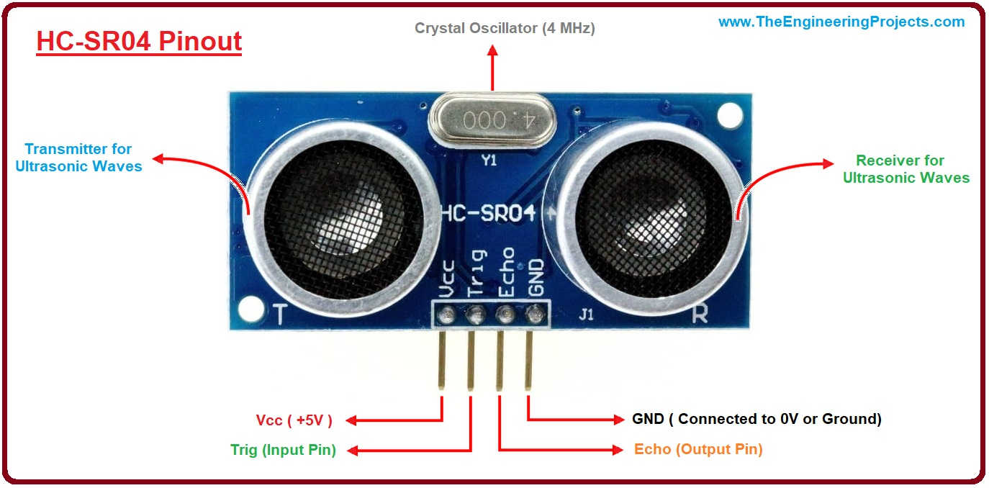
Ultrasonic Sensor

Slide 11
The ultrasonic sensor works on the principle of ultrasound waves which is used to determine the distance to an object. An ultrasonic sensor generates high-frequency sound waves.
By using the time required for the echo to reach the receiver, we can calculate the distance to an object we are targeting.
Ultrasonic distance sensor consists of two ultrasonic transducers. Among them, one acts as a transmitter which converts the electrical pulse of a microcontroller into ultrasonic sound pulse and the receiver receives the transmitted pulses.
If it receives them, then it produces an output pulse whose time period can be used to determine the distance from the object.
Distance= (Time x Speed of Sound in Air (340 m/s))/2

Slide 12
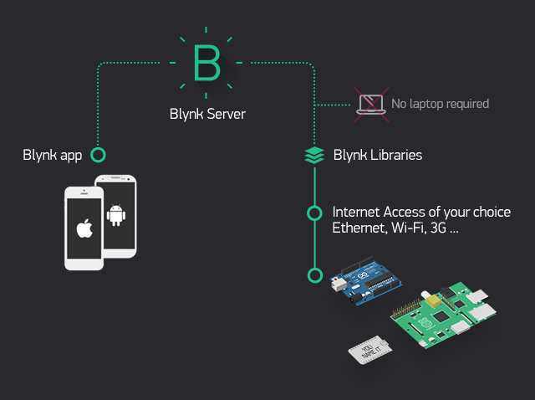
Blynk

Slide 13
Blynk was designed for the Internet of Things.
It can control hardware remotely, it can display sensor data, it can store data, visualize it and do many other cool things.
There are three major components in the platform. Blynk Server - responsible for all the communications between the smartphone and hardware.

Slide 14
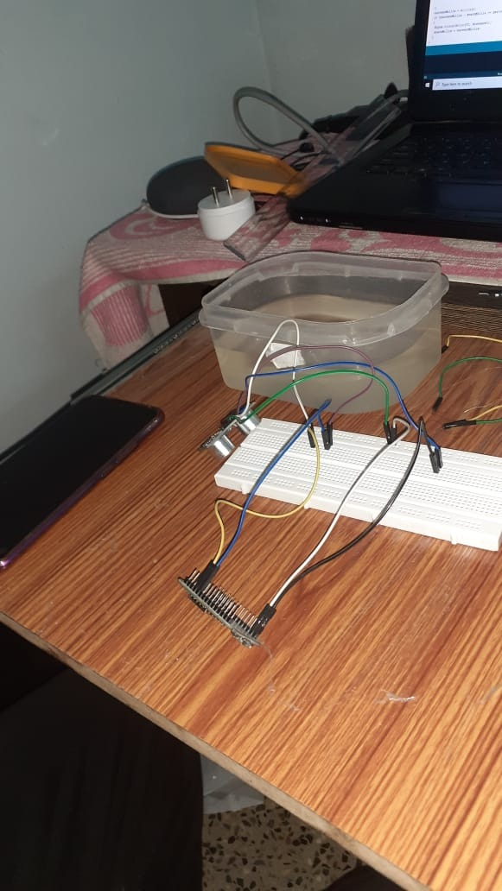
HARDWARE IMPLEMENTATION

Slide 15
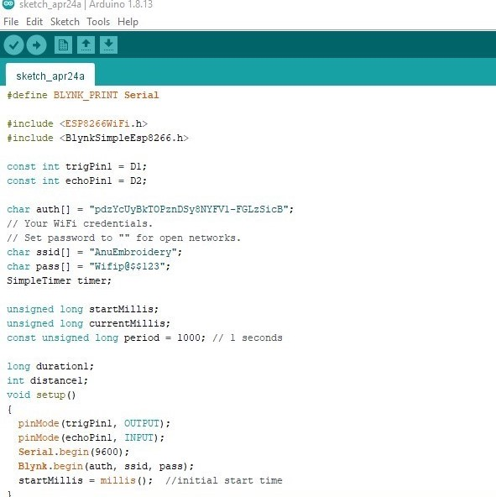
DATA ACQUISITION FROM THE SENSOR

Slide 16
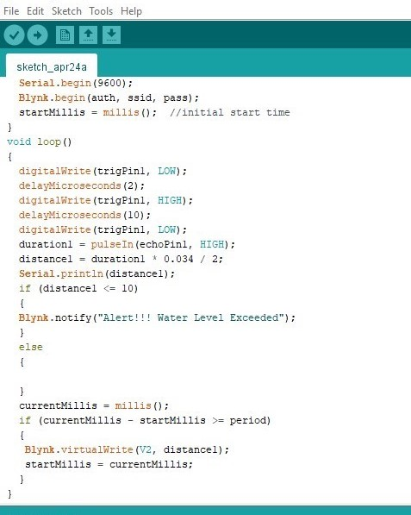

Slide 17
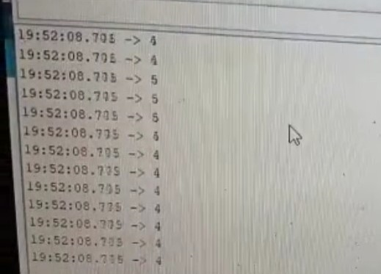
O U T P U T

Slide 18

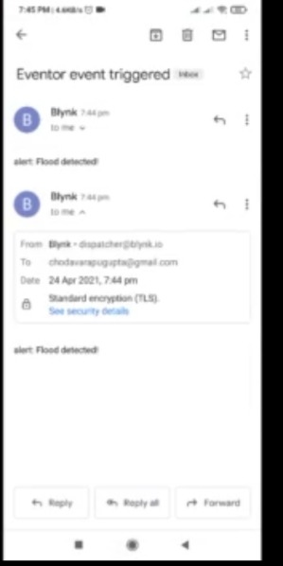
BLINK OUTPUT

Slide 19
PREDICTION

Slide 20
References
H. N. Do, M. Vo, V. Tran, P. V. Tan, and C. V. Trinh, “An Early Flood Detection System Using Mobile Networks,” International Conference on Advanced Technologies for Communications (ATC), pp. 599–603, 2015.
M. Mousa, X. Zhang, and C. Claudel, “Flash Flood Detection Proceedings of the International Conference on Intelligent Computing and Control Systems (ICICCS 2019) IEEE Xplore Part Number: CFP19K34-ART; ISBN: 978-1-5386-8113-8 978-1-5386-8113-8/19/$31.00 ©2019 IEEE 1485 in Urban Cities Using Ultrasonic and Infrared Sensors,” IEEE Sensors Journal, vol. 16, no. 19, pp. 7204–7216, 2016
M. Khalaf, A. J. Hussain, D. Al-jumeily, P. Fergus, and I. O. Idowu, “Advance Flood Detection and Notification System based on Sensor Technology and Machine Learning Algorithm,” ” pp. 105–108, 2015.

